Slide 1
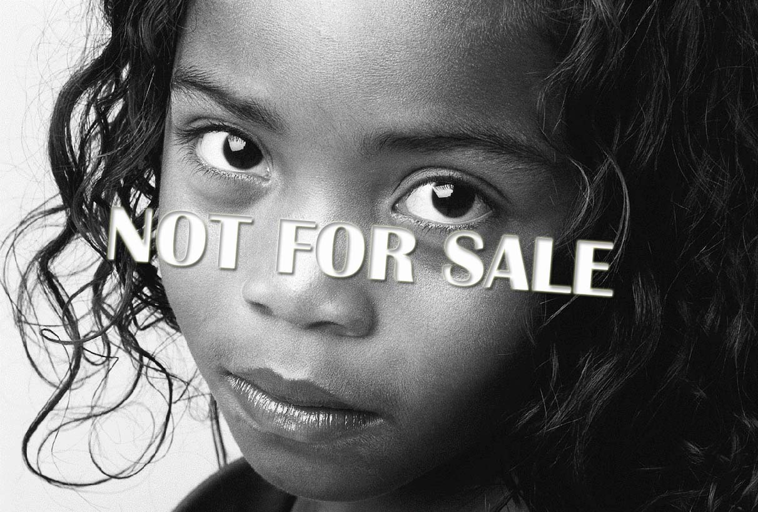
Child Trafficking
By: Nikita Mirpuri

Slide 2
RAISE YOUR HAND
IF YOU
IN THE
UNITED STATES NO
LONGER .
THINK
SLAVERY
EXISTS

Slide 3
YOU ARE…
WRONG!
Notes:
Child trafficking is considered the modern day slavery.

Slide 4
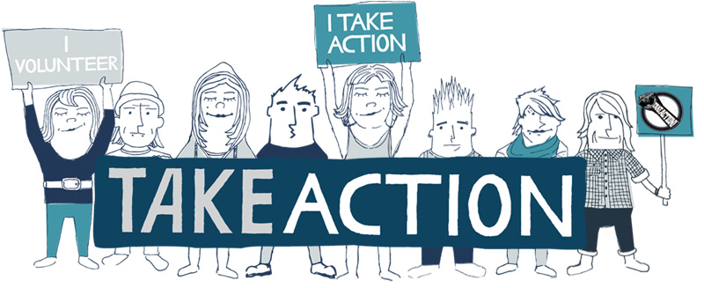
Thesis Statement
I am doing this presentation to inform and educate others about the atrocities of child trafficking, as well as to expand their knowledge of this horrible practice and influence them to take action against it in whatever ways they can.

Slide 5
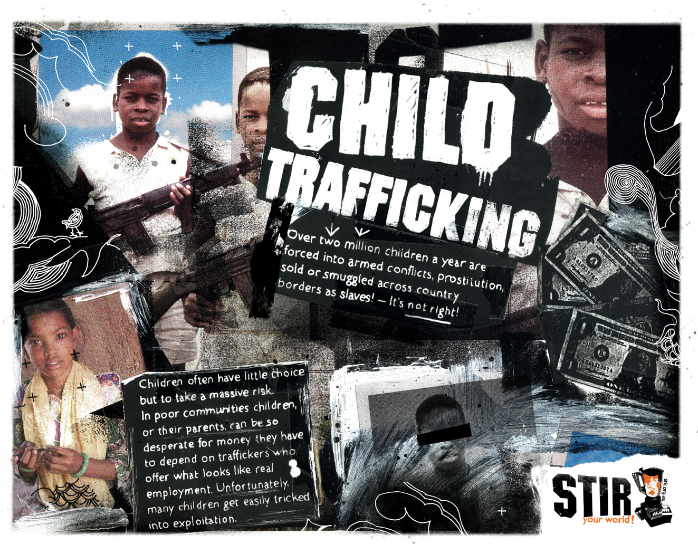
Personal Relevance
Notes:
The reason I chose to study this topic is mainly because I have always knew that child trafficking exists and in the back of my mind I knew not many people knew about this problem going on in not only our country but globally. It bothered me that child trafficking is covered and not talked about, so I decided to speak for those who could not speak and have the courage to show my peers the truth. Another reason I decided to choose this topic is because it hits close to home for me. I was born in Togo a western African country, and child trafficking not only exists it is not un common. Last year I read an article about a Ghana women in New Jersey trafficking women from Togo and making them work in her salon. She has been caught and prosecuted. But this story is also the main reason why I chose this topic.

Slide 6
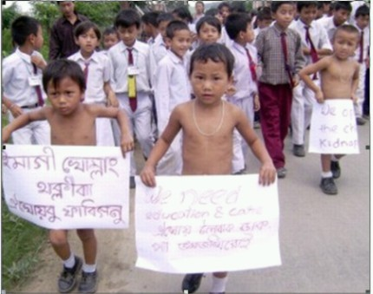
What is Child Trafficking?
A form of human trafficking…
The recruitment, transportation, transfer and harboring of children for the purpose of exploitation.
“Human Trafficking.” Encyclopedia of Race and Racism. Ed. John Moore. Vol. 2. Global Issues in Context. Web. 3 Dec. 2009.Detroit: Gale, 2008. 134-38.
Notes:
Any act or transaction where a child is transferred by any person or a group of people for money or any other form of payment.
Child Trafficking occurs everywhere, it is discreet and not talked about mainly because it is something people would rather not talk about or acknowledge that it is going on in our time today.
Child trafficking is the exploitation of children sold and bought for slavery or for sexual purposes.
It is also known as sexy trafficking which is by force, fraud, or coercion or in which the person is induced to perform such an at is under 18. It is involuntary servitude, debt bondage and slavery.

Slide 7
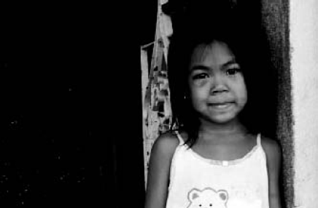
Modern Day Slavery
Child Trafficking is considered to be the modern day slavery.
There are twenty-seven million humans in slavery today
In forms of:
Sex trafficking,
Domestic servitude,
Factory and farm slavery,
Child soldier slavery.
Tran, Jonathan. “Sold Into Slavery.” Christian Century 124.24 (2007): 22. eLibrary. Web. 2 Dec. 2009.
Notes:
Slavery is often fueled by commercial gain.
Trafficking alone is estimated to have a nine billion dollar profit for those involved each year.
Modern day slavery is considered human trafficking, which includes children.
They ship slaves from their homes to another land for purposes of enslavement.
According to the U.S. Department of State approximately 600,000 to 800,000 victims are trafficked across international borders worldwide. Of those victims 14,500- 17,500 victims are trafficked into the U.S.

Slide 8
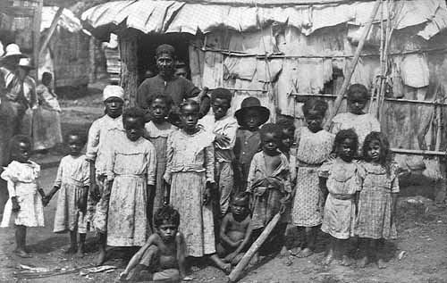
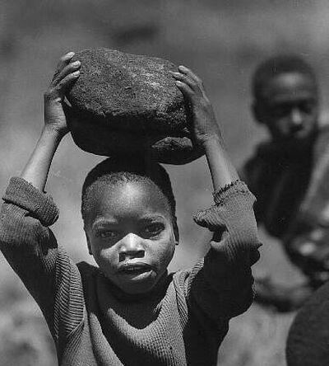
SLAVERY Cont.
Blackwill, Robert D. “Dealing with trafficking in persons: Another dimension of United States and India transformation.” DISAM Journal of International Security Assistance Management 25.4 (2003): 58. eLibrary. Web. 3 Apr. 2010.
Notes:
In the beginning slavery used to be a common thing around the globe, especially in the United States.
From the 16th to the 19th centuries, approximately 645,000 slaves were brought to the United States.
By the 1860, the United States slave population grew to 4 million.
The Emancipation proclamation and the 13th Constitutional Amendment of the mid 1860s were thought to have abolished slavery in the United States.
However the trafficking of children and trafficking in general is considered slavery.
Therefore slavery has never been completely abolished.
It has been pushed, shoved and ignored, but is now making its way into the minds of millions and is becoming a global fight to stop it.
The global recognition of human trafficking has brought modern day slavery to light after many years of it being in the dark.

Slide 9
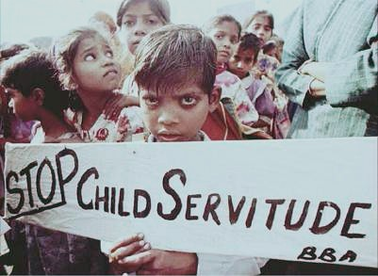
Millions of Victims
1.2 million…
profit of…
2 million…
children and babies are trafficked annually worldwide.
$9.5 billion every year.
children are exploited in the transnational sex trade.
Buckley, Mary. “Young and Vulnerable.” The World Today 64 (Aug. 2008): 16. eLibrary. Web. 3 Apr. 2010.
Notes:
Experts all agree that the estimates of child trafficking are unreliable because of the ‘hidden” nature of the crime, but the Save the Children UK’s report last year suggested these numbers.
It is predicted that from those 1.2 million children and babies that have been trafficked worldwide the traffickers profit from the crimes were about $29.5 billion.
The majority of the victims are girls, but the exploitation of boys is effective.
Reports point out that social stereotypes presume boys cannot be exploited in prostitution, when in reality it is happening in the countries of, for example Sri Lanka, Mexico and the Dominican Republic, where they are pimped by other men or boys.
In other countries like Czech Republic and Britain they are called “rent boys”

Slide 10
Did you know???
2 children are sold into trafficking every minute.
Notes:
By the time this presentation is over there will be 25 children will be sold into trafficking. Which is more than half of this class.

Slide 11
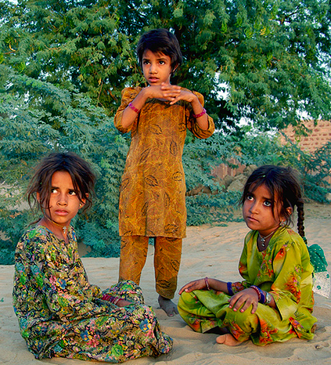
Impact of Trafficking on Victims.
support
Loss of
from family and community
Loss of proper
Obstacles in physical development
Psychological Traumas
education
Miller, John R. “Slave Trade.” Harvard International Review 27 (Jan. 2006): 70. eLibrary. Web. 3 Apr. 2010.
Notes:
Loss of support from family and community, with possible further exclusion and resistance.
Loss of proper education, hence lower possibility to support themselves in the future
Obstacles in physical development: premature sexual experience, forced drug abuse, contraction of STD’s and etc.
Psychological Traumas: feeling of isolation, deprivation an loss of control over life

Slide 12
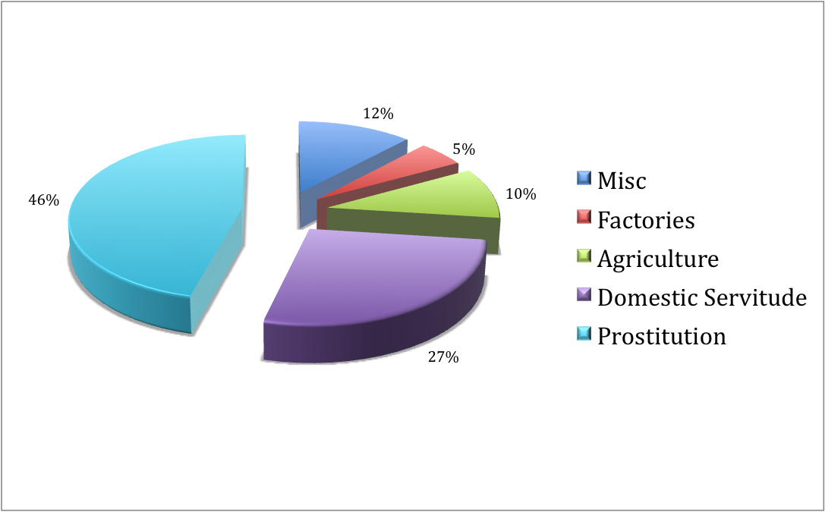
What Sector of Trafficking
Beyrer, Chris. “Global Child Trafficking.” Lancet 1 Dec. 2004: 16. eLibrary. Web. 2 Dec. 2009.
Notes:
These are the five major sectors of trafficking that young children are forced into.
The largest one being prostitution, which is the buying, selling, and trading of children for sexual purposes.
The second largest is domestic servitude, which is a performance of household services for an individual or a family, in these cases they are abused and not treated well.
The third largest would be miscellaneous, where it could be a variety of different things such as: working in restaurants or begging on the streets for money.
The main person that owns the child or children will make them beg on the streets for money and then they will give it to them.
Fourth largest is agriculture, which is farming and outside work, they are not treated well and are mostly abused, money is not provided. The fifth largest is working in factories and sweatshops around the globe.
Small children are sold to big companies in foreign countries where they are forced to live and work for small amounts of money or no money at all in unsuitable conditions and environment.

Slide 13
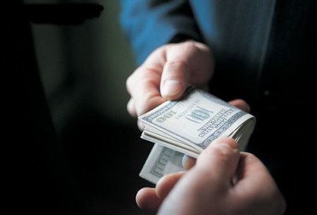
WHO ARE THE BUYERS?
People who have money:
Doctors
Lawyers
Accountants
Gamblers
Politicians
High ranking people in our government
… people you never
expected.
Tran, Jonathan. “Sold Into Slavery.” Christian Century 124.24 (2007): 22. eLibrary. Web. 2 Dec. 2009.

Slide 14
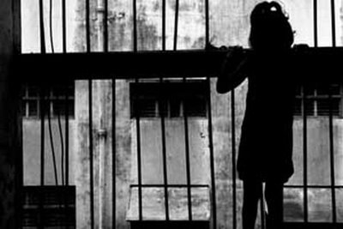
Why do Victims Fall Prey?
Political instability
Militarism
Civil unrest
Natural disasters in homeland
Promises of economic opportunities or a better life.
Hodge, David R. “Sexual Trafficking in the United States: A Domestic Problem with Transnational Dimensions.” Social Work 53.2 (2008): 143. eLibrary. Web. 3 Dec. 2009.
Notes:
Victims fall prey to child trafficking mainly because of these reasons.
Political instability in a country, meaning deaths or economic crisis can cause child trafficking to rise because the instability of the country makes these practices more convenient and less noticeable.
Militarism is also another factor that victims can fall prey into because when a country is preparing their military for war or any other practice of that nature children can be trafficked to join such things.
Civil unrest in a country can also draw many victims into child trafficking mainly because the group causing havoc in the country are involved in trafficking and try to recruit young children into their group by stealing them from their families or orphanages.
Natural disasters in the homeland is one of the big reasons why victims fall prey to child trafficking.
When natural disasters strike it can destroy homes, farmlands, buildings, etc.
During that time the rise of child trafficking increases because sometimes parents sell their children for food, or the children are pulled out of school and forced to beg on the streets for money.
Disaster pushes children and their families over the edge into destitution and desperation, which can lead to families sending away their young ones into the work force, which ends up in slavery.
The last one, is promises of economic opportunities or a better life, which is a trick to get young children to believe that they will be well taken care of and that ends up with them trafficked around the world.
This is one of the largest ways children are trafficked into believing that they will receive a better life.
Also certain social and cultural practices increase vulnerability to traffickers.
The fear of HIV/AIDS also makes young children increasingly attractive to traffickers, because of their innocence and purity.

Slide 15
Gender and Age
Tran, Jonathan. “Sold Into Slavery.” Christian Century 124.24 (2007): 22. eLibrary. Web. 2 Dec. 2009.
Notes:
Gender and age in the trafficking world are very different for boys and girls.
Mostly girls are trafficked but there are 20% of boys that are trafficked also mostly for labor, but prostitution is a part too.
From human trafficking in general 50% of them are under 18 and 50% are adult, meaning above 18.

Slide 16
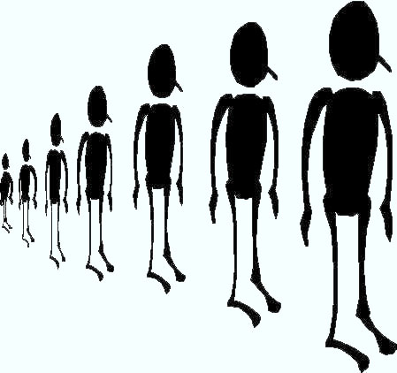
Children = Not Prostitutes
Young boys and girls in every city…
Sex trafficking masks itself…
General public does not feel outraged.
on the globe today are forced
to serve as sex slaves.
as prostitution.
Tran, Jonathan. “Sold Into Slavery.” Christian Century 124.24 (2007): 22. eLibrary. Web. 2 Dec. 2009.
Notes:
The children are perceived to be criminals, sexual deviants or victims of their environment
Desperate for survival
Some are convinced the kids “choose” to sell their bodies for profit.
When in reality their being exploited, abused, and trafficked.
Sex traffickers target twelve to seventeen year old children as their top choice candidates.
The idea is that any older and they start to lose their youthful appeal, while any younger and they may draw the attention of law enforcement.
When the inner works of sex trafficking is exposed, people realize that no child would volunteer their bodies for such exploitation.

Slide 17
Recruitment and Extraction
Fraud
Trickery
False promises
Familiarity
Beyrer, Chris. “Global Child Trafficking.” Lancet 1 Dec. 2004: 16. eLibrary. Web. 2 Dec. 2009.
Notes:
These are the four ways traffickers recruit and extract young children from their homes, families, orphanages, schools, etc.
Traffickers only on rare occasions will abduct a child from a neighborhood, doing so is a high risk however.
The risk of the extensive search of that child is a great risk and if caught recruiters can face prosecution.
Recruiters deceive middle to lower class families more easily with promises of a better life.
They glamorize the though of a steady job, which causes parents to overlook the risks of sending their child off to another country. Teenagers might be promised modeling jobs or a high-paying job in the restaurant industry or a retail store.
Sometimes parents of young children in rural areas are told that a wealthy family is in need of a servant or a nanny.
All of these offers that recruiters make is to extract children from anyone who might care for them.
The recruiters have no intention of fulfilling the promises they made, they intend to sell the children to a brothel, into factories, landowners, or slavery.
Lower to middle class families with high goals of a better life can be vulnerable to traffickers.
Parents with materialistic needs are at times willing to put their children in dangerous situations.
It is not uncommon for parents to deliver a child to a recruiter even if they are fully aware that their child will be exploited.
The recruiter might go to the full extent to even pay the parents with a cash advance of their child’s future earnings, with the promises of more payments to come.
Recruiters make these arrangements to establish a steady trade in the region and so that other families see the recruiters credibility plus the financial rise of other families that sold their children and that might make them more willing to sell their own children.

Slide 18
Control
Once taken
Sold to slaveholders
Who deal in commercial sex:
Pimps
Owners of strip clubs
Sex bars
Brothels
Massage parlors
“Human Trafficking.” Encyclopedia of Race and Racism. Ed. John Moore. Vol. 2. Detroit: Gale, 2008. 134-38. Global Issues in Context. Web. 3 Dec. 2009.
Notes:
Child is kept closely guarded and is stripped away of passports, birth certificates, identity cards, and any other documents.
Most traffickers have a steady relationship with the slaveholder, they who the buyer will be before they recruit the child.
Some traffickers act as both recruiter and operator of their own sex shop.
The slaveholder quickly takes complete control of the child’s life, by stripping away documents.
The child is guarded and locked in a room when not with an adult.
There is usually no way of escape and if there is the child has no money, probably does not speak the local language, and does not know who to turn to for help.
From past experiences some slave children would not trust the public officials or the police.
The slaveholder manipulates the relationship of financial dependence with the child.
Basic things such as: food, clothing and shelter are charged to the child’s “account”.
Until that money is paid off the child is obligated to continue in the slaveholders service.

Slide 19
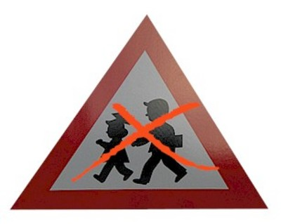
Violence
Slaveholders:
keep things in control by the constant
Trafficked children are victims of an
Within the first forty-eight hours
Through rape or beatings
threat of violence.
extreme act of violence
“Human Trafficking.” Encyclopedia of Race and Racism. Ed. John Moore. Vol. 2. Detroit: Gale, 2008. 134-38. Global Issues in Context. Web. 3 Dec. 2009.
Notes:
Almost all trafficked children are victims of an extreme act of violence
Slaveholders use violence to imprint their dominance
They never let the child slip out of a state of terror.
For the slaveholders the child will have to learn to comply happily with whatever sexual act a client requests.
If a client ever complains that the child was not the best he/she could be, brutal punishment will be given to them.
The threat of violence becomes a huge force in the life of a child sex slave.
The child knows that a failed escape attempt would result in a severe beating.
The slaveholder may also threaten to harm the child’s family even if the child does manage to get away.
To make sure the child does not try to escape the slaveholder may say some current news about family members, true or fake to make the child feel that they are watching family members.

Slide 20
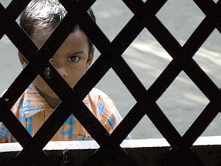
Coercion
Threats of serious harm to, or physical restraint of any person.
Traffickers make their victims believe that there is no way to…
escape
United States Congress. “Section 2423. Transportation of Minors.” Gender Issues and Sexuality: Essential Primary Sources. Ed. Brenda Lerner and Adrienne Lerner. Detroit: Gale, 2006. 411-12. Global Issues In Context. Web. 3 Dec. 2009.
Notes:
A scheme or plan that is made to the victim to believe that failure to perform an act would result in serious harm.
They force them to do what they want by threats of violence, threats to their loved ones, and they even go as far as to make them scared of authorities such as police, who could help them.
They make them believe that the police is on their side and will even go to the extent to say that they are not from this country and will be in serious trouble.
They being children and scared and in a different country most likely will go along with what their trafficker has said.

Slide 21
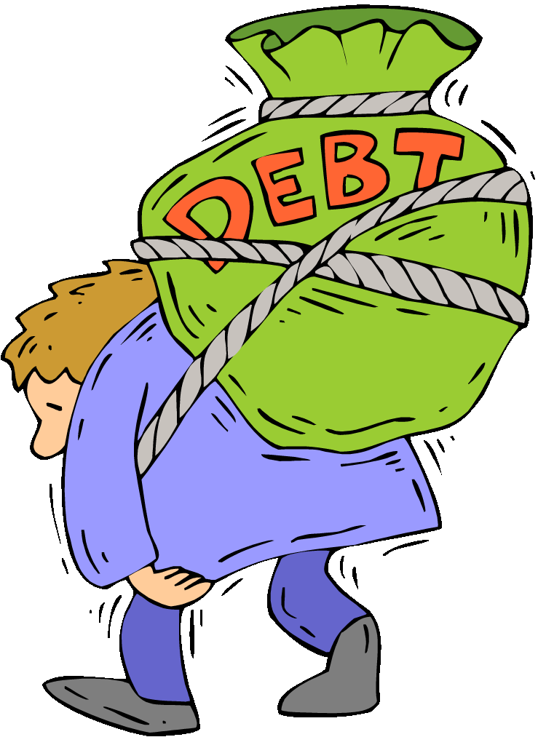
DEBTS
Victims are often subjected to debt-bondage
Paying off transportation fees into the destination countries.
It is a…
the only way out is escape.
never ending cycle
Hodge, David R. “Sexual Trafficking in the United States: A Domestic Problem with Transnational Dimensions.” Social Work 53.2 (2008): 143. eLibrary. Web. 3 Dec. 2009.
Notes:
By the time they pay their fees for transportation they have collected more with food and shelter.
Once the victim has a debt to pay the cycle never stops.
The trafficker will continually add necessary items such as food and shelter onto their tab, so that they cannot be freed.
Fines for not meeting daily quotas of service or “bad” behavior are also used by some trafficking operations to increase debt.
The only way they can pay off their debt is by prostitution or labor, even then they money they make does not necessarily go towards their debt.
In fact Most trafficked victims rarely see the money they are supposedly earning and may not even know the specific amount of their debt.

Slide 22
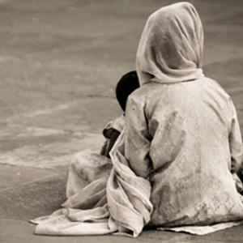
Industry of Exploitation
“(The clients) say that because they do not use violence to force the child or adolescent to have sex,
They do not identify the children and adolescents as victims of sexual exploitation.”
the situation does not violate the minor’s human rights.
Miller, John R. “Slave Trade.” Harvard International Review 27 (Jan. 2006): 70. eLibrary. Web. 3 Apr. 2010.
Notes:
Child trafficking is the industry of exploitation, most people are unaware of the idea that young children who sell their bodies for sex do not operate alone.
An entire underground economy is built around sex slaves. Economic sectors profit from exploitation.
Major cities around the globe host annual convention or other big events for the sex trade itself.
The hotels, restaurants, night clubs, taxis, airports, etc. all benefit from the trades.
A single child trafficked can bring significant benefits to the cities.
The only people who do not gain financial benefits from the industry are the ones who the whole network depends on, which are the slaves.

Slide 23
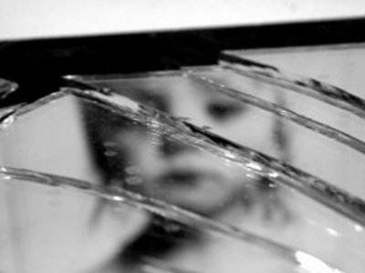
Supply and Demand
3 key points:
As long as there is a demand for child sex slaves the supply
Consumers of trafficking mainly want them for
The demand continues to grow all over the globe, therefore
will continue to grow.
profit and exploitation.
the supply is being met.
Beyrer, Chris. “Global Child Trafficking.” Lancet 1 Dec. 2004: 16. eLibrary. Web. 2 Dec. 2009.
Notes:
There has been an explosion in the demand for child prostitutes by sex tourists.
They are perceived to cure illnesses and bring prosperity.
Some people believe they will not transmit AIDS from child prostitutes, as children are seen to be pure.
Traffickers respond to the demand and began to traffic children across boarders in large numbers.
Trafficking is defined by the United Nations as the buying or selling of a person for exploitation through the idea of supply and demand. If there was no demand for young children as sex slaves then there would be no supply.
However there is a large amount and according to the recent United States government report, at least 800,000 to 900,000 people, mostly young women and children are trafficked worldwide because of the demand.

Slide 24
Miller, John R. “Slave Trade.” Harvard International Review 27 (Jan. 2006): 70. eLibrary. Web. 3 Apr. 2010.
Notes:
These are the states in the United States that currently have trafficking activity.
Every day there are more and more states which have trafficking activity within them.
It is said that every 10 minutes, a person is trafficked into the United States.

Slide 25
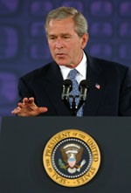
Supply and Demand Cont.
“Stopping this abuse requires going after the criminal gangs who SUPPLY the sexual predators.
But we cannot put them out of business until and unless we deal with the problem of DEMAND. And so that's why we are going after the unscrupulous adults who prey on the young and the innocent.“
Bush, George W. “Remarks at the National Training Conference on Human Trafficking in Tampa, Florida.” Weekly Compilation of Presidential Documents 40.29 (2004): 1309. eLibrary. Web. 1 Dec. 2009.
Notes:
Former President George W. Bush, speaking at the Nation Training Conference on human trafficking on July 16,2004 specifically mentioning about the supply and demand about this industry and that there is no way to end this business without first ending the demand.

Slide 26
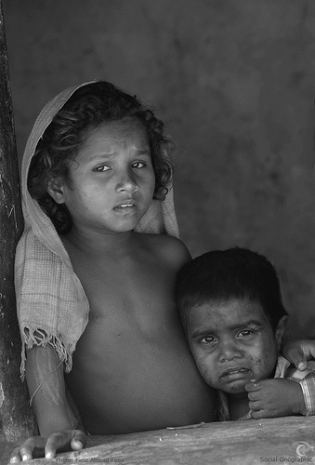
Laws
The laws against trafficking in the US exist at the federal and state levels.
Half of the states now criminalize human trafficking
Through the penalties are not as tough as the federal laws
United States Congress. “Section 2423. Transportation of Minors.” Gender Issues and Sexuality: Essential Primary Sources. Ed. Brenda Lerner and Adrienne Lerner. Detroit: Gale, 2006. 411-12. Global Issues In Context. Web. 3 Dec. 2009.
Notes:
Federal and state efforts focus on regulating the tourism industry to prevent sex tourism.
Under the Title 18 of the United States Code section 1584 makes it a crime to force a person to work against his will.
Section 1581 similarly makes it illegal to force a person to work through debt servitude.
The Victims of Trafficking and Violence Protection Act of 2000 allowed for maximum sentences for traffickers, provided resources for protection, and assistance for victims of trafficking.
Several state governments have taken action to address human trafficking in their borders, either through legislation or prevention activities.
Florida state law prohibits forced labor, sex trafficking, and domestic servitude.
As of 2006 Connecticut law prohibits forced work and makes trafficking a violation.
Washington State was also the first state to pass a law criminalizing human trafficking in 2003.

Slide 27
Miller, John R. “Slave Trade.” Harvard International Review 27 (Jan. 2006): 70. eLibrary. Web. 3 Apr. 2010.
Notes:
In 2004 the number of trafficking prosecutions were especially evident in Europe, Eurasia, and South Asia, which on the map is the darkest areas shaded.
Even though such cases were a lot fewer in the Western Hemisphere, Africa, and the Near East, this statistic represents the number of criminal cases pursued.
It does not give any number or idea of human trafficking victims across the world.
This chart however does show that countries are finally trying to stop this from happening.

Slide 28
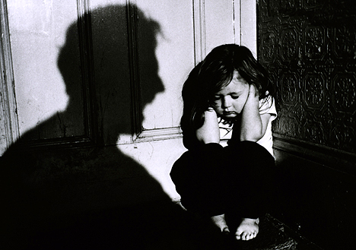
Impact of Trafficking on Society
Fuels organized crime
Deprives countries of human capital
Promotes social breakdown
Undermines public health
Subverts government authority
Imposes enormous economic cost
Beyrer, Chris. “Global Child Trafficking.” Lancet 1 Dec. 2004: 16. eLibrary. Web. 2 Dec. 2009.
Notes:
These are the impact on what trafficking has on society.
Once trafficking has started in a particular country it is hard to control, therefore it fuels organized crime and continues to grow within that country and spread to other countries.
Human capital of the countries deprive and public health becomes an issue because of the dangerous living conditions and the sexual diseases that come up with prostitution.
It destroys government authority because the crime is “hidden” so well under prostitution and other ways that it is hard for the government to recognize whether it is child trafficking or not.

Slide 29
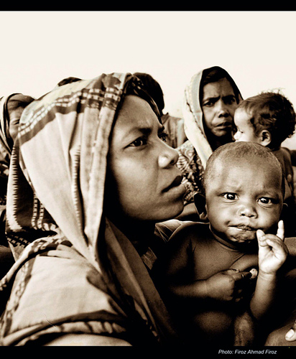
Health Issues
Trafficking of children is a global public health issue.
Health issues are usually ignored until they are critical or life-threatening.
Child trafficking is not being ignored anymore.
Todres, Jonathan. “Root out child trafficking with prevention.” The Atlanta Journal and Constitution (Feb. 2010): n. pag. eLibrary. Web. 2 Apr. 2010.
Notes:
Mainly because of the health issues that are coming up with this crime.
The health issues that are related to child trafficking depend on what sector of child trafficking the child is in.
Children who live in dirty and crowded living conditions, coupled with poor nutrition, cause health conditions such as scabies, tuberculosis and other communicable diseases.
When working in agriculture, sweatshop or construction conditions chronic back, hearing and vision problems may occur.
Long-term untreated issues such as cardiovascular or respiratory problems, diabetes or cancer may be present.
Bruises, scars and other signs of physical abuse and torture may be visible.
Forced prostitution cause sexually transmitted infections, human papillomavirus, pelvic inflammatory disease, permanent damage to reproductive organs and HIV/AIDS.

Slide 30
Health Issues Cont.
Victims of trafficking often endure…
Anxiety
Depression
Sleep disorders
Post traumatic stress disorder
Disorientation
Confusion
Phobias and panic attacks.
Todres, Jonathan. “Root out child trafficking with prevention.” The Atlanta Journal and Constitution (Feb. 2010): n. pag. eLibrary. Web. 2 Apr. 2010.
Notes:
They may suffer feelings of helplessness, shame, humiliation, denial, disbelief or culture shock from being in a strange country. Malnourishment is also a big key factor in the health issues. Especially in child victims malnourishment and dental issues are present almost always. Additionally, children denied social, moral and spiritual development may suffer growth and developmental problems. Substance abuse problems or addictions either from being coerced into drug use by their traffickers or by turning to substance abuse to help cope with or mentally escape their desperate situations.

Slide 31
Reasons we do not speak…
Believe we do not know enough to stop it
“Sex-industry” is well-funded to get out its message
Denial
Not ready for what might happen
Buckley, Mary. “Young and Vulnerable.” The World Today 64 (Aug. 2008): 16. eLibrary. Web. 3 Apr. 2010.
Notes:
The reason why not many have come forth and raised their voices against child trafficking is because many are in denial of the fact that this tragedy exists in our world and even in their own neighborhood.
It is easy to ignore a problem and pretend it doesn’t exist then actually confront it.
Especially something like Child trafficking, some people cannot put their minds around the idea that people buy and sell children for labor and prostitution.
Also even if the topic is brought up it is so big and such a global problem that it will take a lot of time to control and a lot of effort from countries to control this within their own nation.
Some countries are fueled by this industry, therefore shutting it down and stopping it would mean that they lose a lot of money.
That is sometimes the reason why some countries close their eyes and let child trafficking go on, because it brings a great amount of profit and fuels their economy.

Slide 32
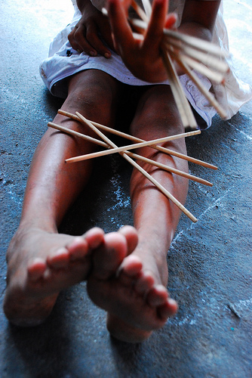
What Happens if we do not speak…
More exploitation of children
Children will suffer in silence
It will continue to be ignored
Traffickers will exploit more children without any fear of prosecution
Countries will continue to let this tragedy happen.
Buckley, Mary. “Young and Vulnerable.” The World Today 64 (Aug. 2008): 16. eLibrary. Web. 3 Apr. 2010.
Notes:
If we do not open our voices and speak for child trafficking and their victims and how it should be stopped all of these points will happen.
Child trafficking will continue to grow and grow more out of control where it comes to a point that there is no way to stop it.
There is still time before that can happen, where we can actually do something to make a difference and stop this atrocity.
If we do not speak People will suffer in silence, not understanding the oppression that has gripped them,
Lives of our most vulnerable will continue to be shaped by a culture of exploitation, and most importantly we will miss a chance to proclaim a message of redemption and transformation

Slide 33
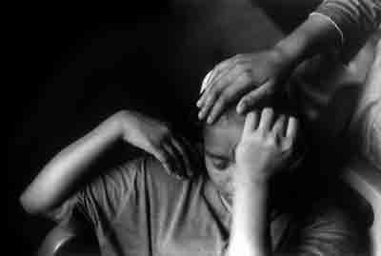
Prevention
Efforts to prevent child trafficking have been concentrated in two main strategies:
Prosecuting and punishing traffickers and their associates.
Giving information to children and their parents about trafficking.
Bush, George W. “Remarks at the National Training Conference on Human Trafficking in Tampa, Florida.” Weekly Compilation of Presidential Documents 40.29 (2004): 1309. eLibrary. Web. 1 Dec. 2009.
Notes:
The prevention of child trafficking is hard, however there are ways to do so.
While also prosecuting and punishing traffickers, national laws are being made to enable such actions.
Also distributing information to the children and their parents are a good way to inform them about abuse inflicted on children who are trafficked and that migrate or are sent away from home to work or earn money for others will be trafficked.

Slide 34
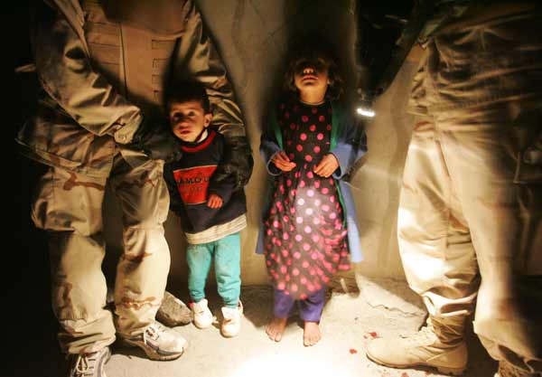
Prevention Cont.
Preventing child trafficking also involves..
Forms of protection available to children.
Includes protection against other types of abuse
Bush, George W. “Remarks at the National Training Conference on Human Trafficking in Tampa, Florida.” Weekly Compilation of Presidential Documents 40.29 (2004): 1309. eLibrary. Web. 1 Dec. 2009.
Notes:
Trafficked children have more likely to have experienced abuse before ever being trafficked.
To prevent child trafficking it also involves taking measures to strengthen the forms of protection available to children.
This includes protection against other types of abuse, which evidence shows, trafficked children are more likely to have experienced than other children before ever being trafficked.
Factors that heighten vulnerability to trafficking are the same as those that increase vulnerability to other forms of violence, abuse and exploitation.
It is important to improve the effectiveness of child protection services and as well as those specifically and directly involved in combating trafficking.
This requires government and government agencies to ensure that children are protected against all forms of discrimination, violence, abuse, exploitation and neglect.

Slide 35
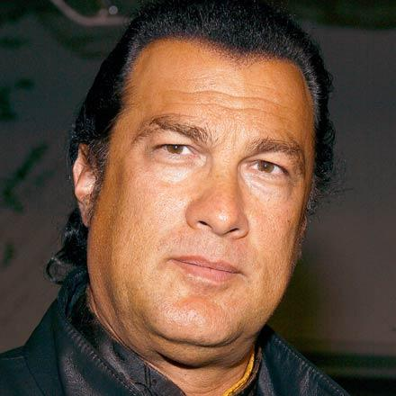
Celebrity Caught!
Sued for illegal Trafficking of females for sexual purposes.
Accused of:
Sexual harassment
Retaliation
Failure to prevent harassment
False representation about employment.
Mrrusssss. “Steven Seagal sued for sexual harassment and human trafficking.” zimbio . N.p., 13 Apr. 2010. Web. 23 May 2010. <http://www.zimbio.com/>.
Notes:
Kayden Nquygen who is Mr.Segal’s assistant has sued him for these charges. She claims that he had assaulted and raped her, that she was only supposed to be his assistant and was locked up in his house in New Orleans, the only way she escaped was when she pretended to go meet her family. She claims she responded to the job post on craigslist and was flown to a remote home in New Orleans. When she arrived there was also another 19 year old Russian model in that house as well. Steven Seagal is specially accused of hiring young girls as his personal assistants whose real job was to serve him in whatever ways he wanted.

Slide 36
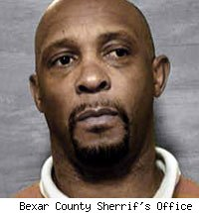
FORMER NBA PLAYER CAUGHT!
Alvin Robertson
Charged with:
Sexual assault of a child
Trafficking an underage child for purposes of sex.
Forcing a sexual performance by a child.
FanHouse Newswire. “ Alvin Robertson Apprehended, Charged With Sex Trafficking.” NBA Fanhouse . Aol Sports , 2 Feb. 2010. Web. 23 May 2010. <http://nba.fanhouse.com/>.
Notes:
Authorities claimed that former 47 year old Spurs star was part of a ring that kidnapped a 14 year old girl from San Antonio, and forced her to have sex with clients and to dance at a strip club. The girl escaped somehow, which prompt the investigation. Seven people have been arrested, including Robertson’s girlfriend.

Slide 37
The Numbers
1.2 million children trafficked
11 years old is the average age
100,000 children and young women trafficked in the US.
200,000 US children at risk for sexual exploitation.
30 years in prison if caught
$9.5 billion made by human trafficking.
Scimone, Diana, et al., prod. Born2fly International. Born to Fly International, Inc., 2008. Web. 1 Dec. 2009. <http://www.born2fly.org/>.
Notes:
There are 1.2 million children trafficked each year for sex around the world.
The average age of sex workers around the world is around 11 years old and some of them are as young as 5 years old.
There are 100,000 children and young women who are trafficked in the United States today, they range from 9 to 19 years old in age. There are 200,000 children in the U.S. who are at risk for commercial sexual exploitation.
U.S. citizens can spend 30 years in prison if they are convicted of traveling to another country and engaging in child sex tourism.
Every year the money generated from human trafficking Is about $9.5 billion.
Human Trafficking is the 3rd most largest in- come generating problem in our world today.

Slide 38
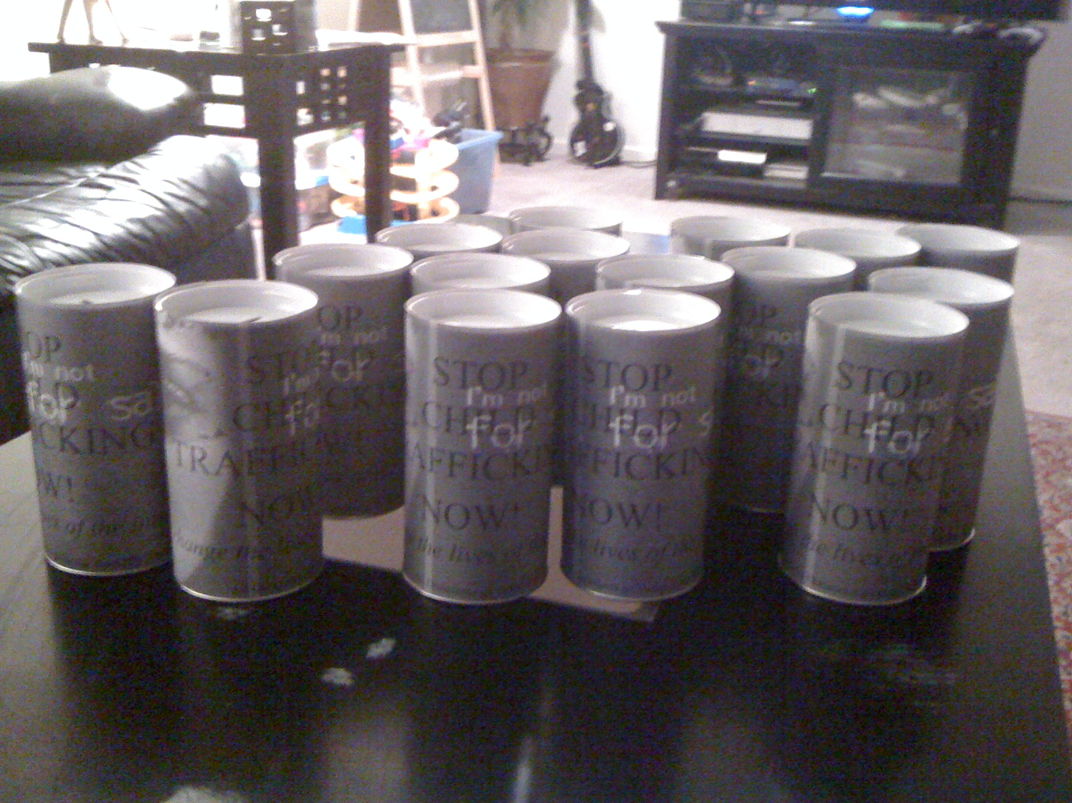
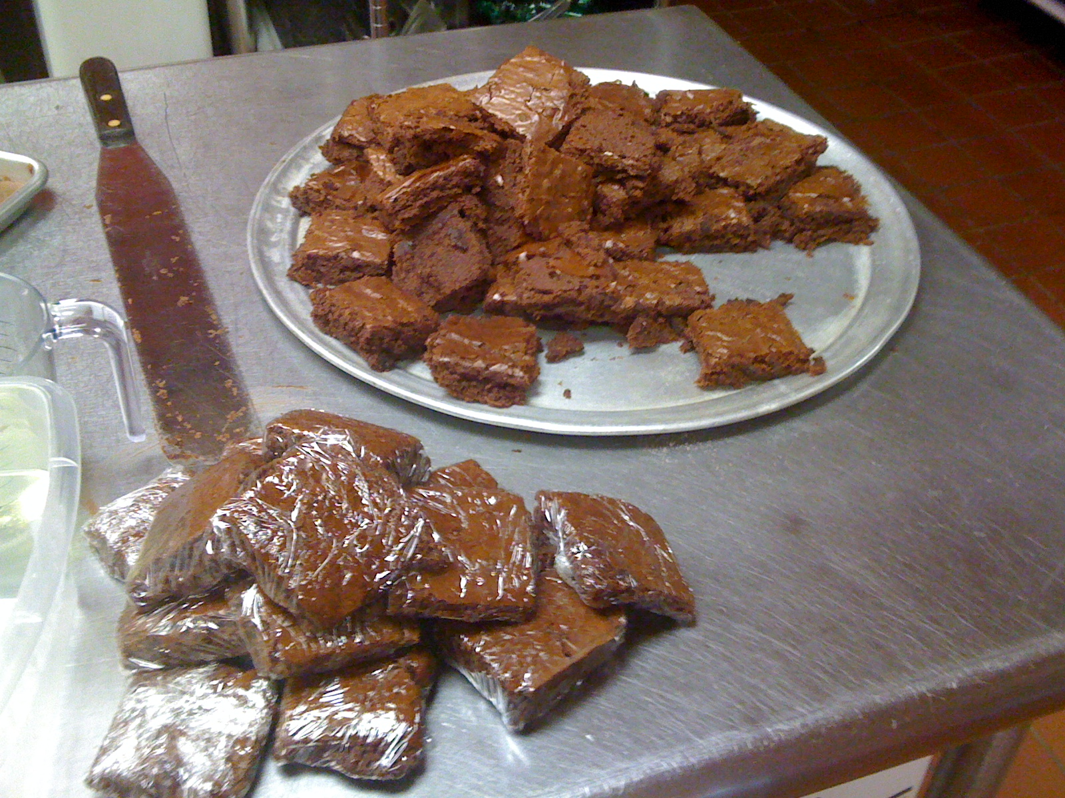
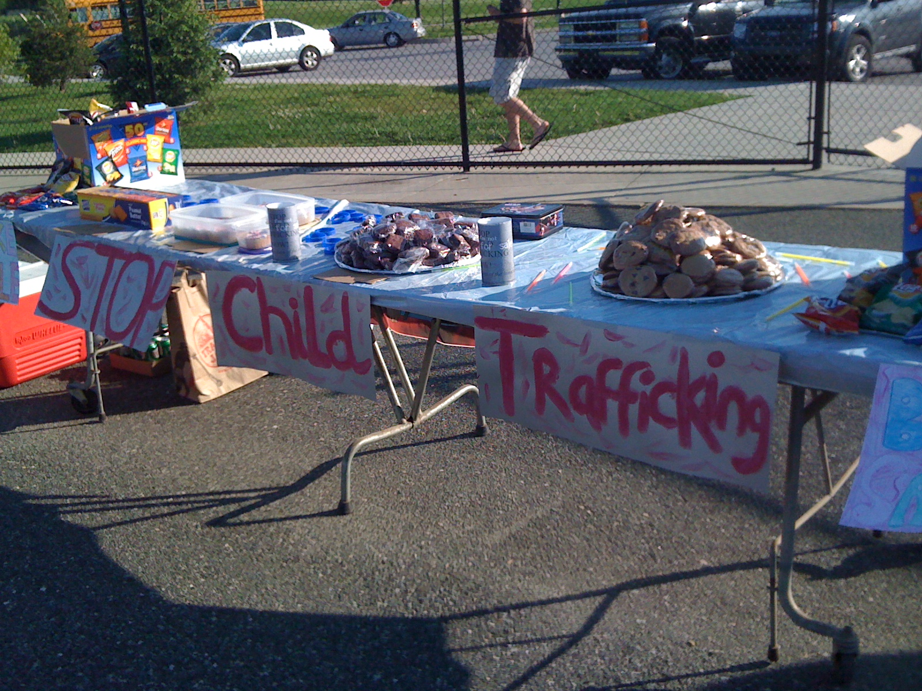
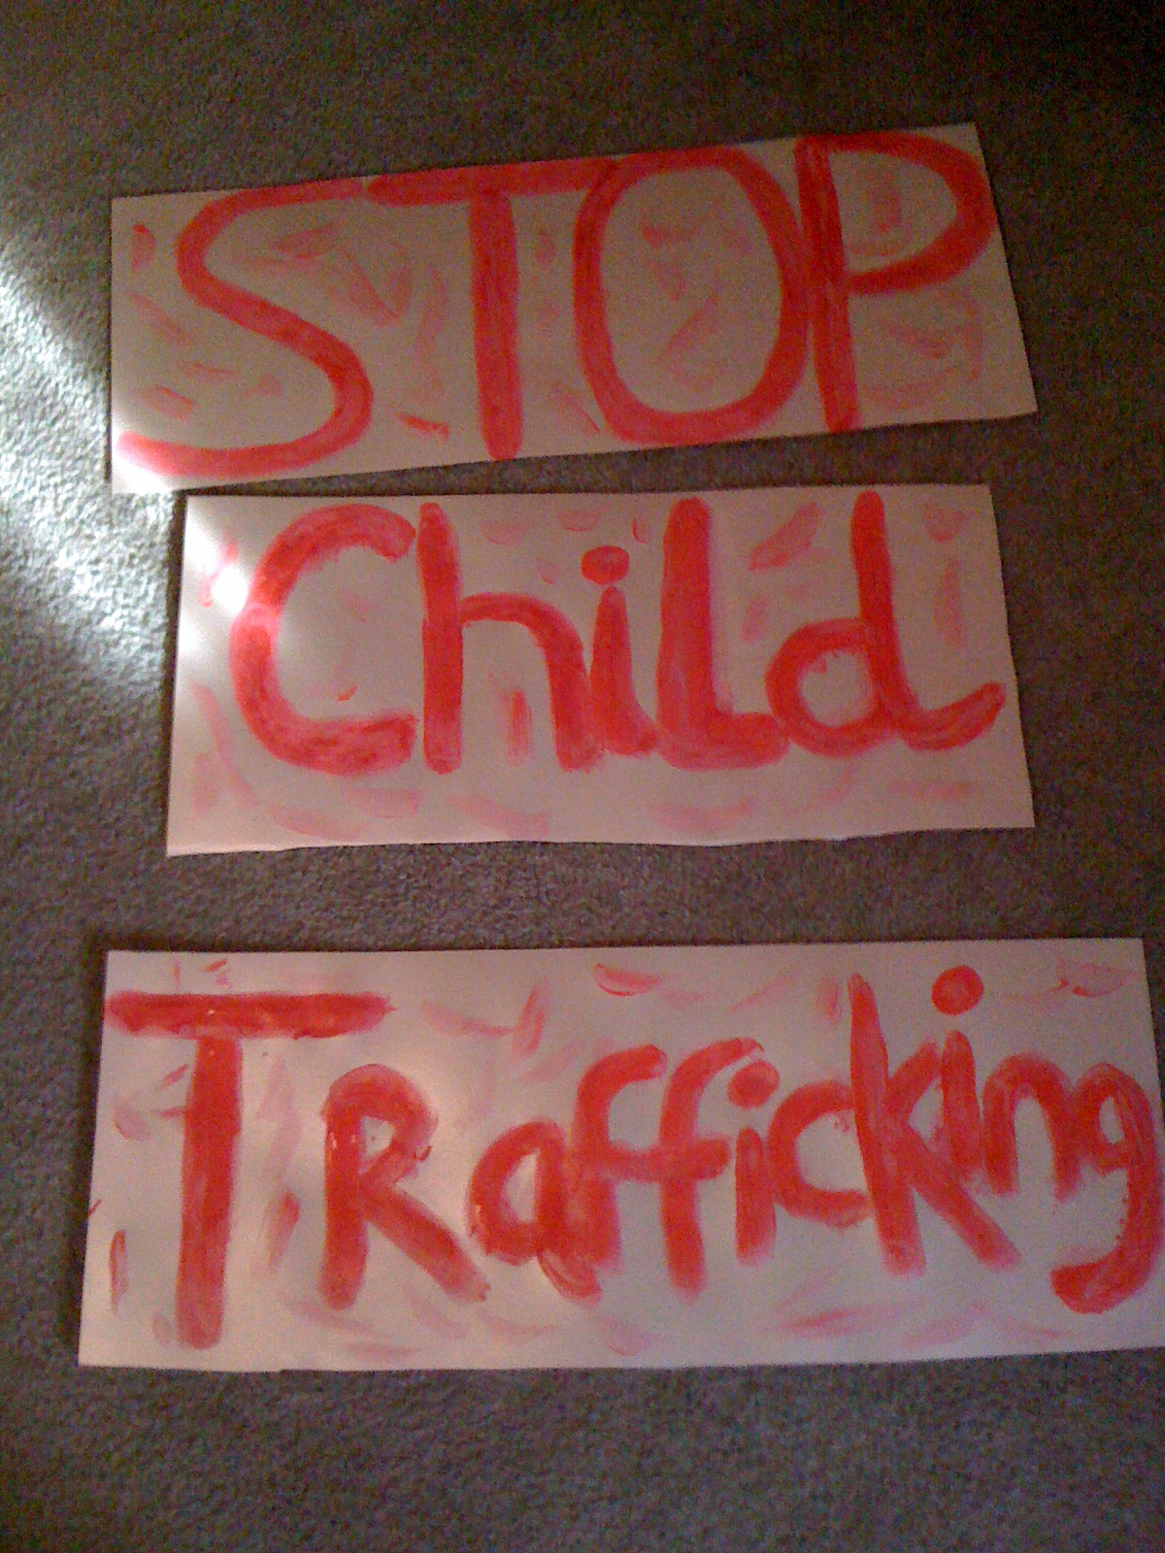
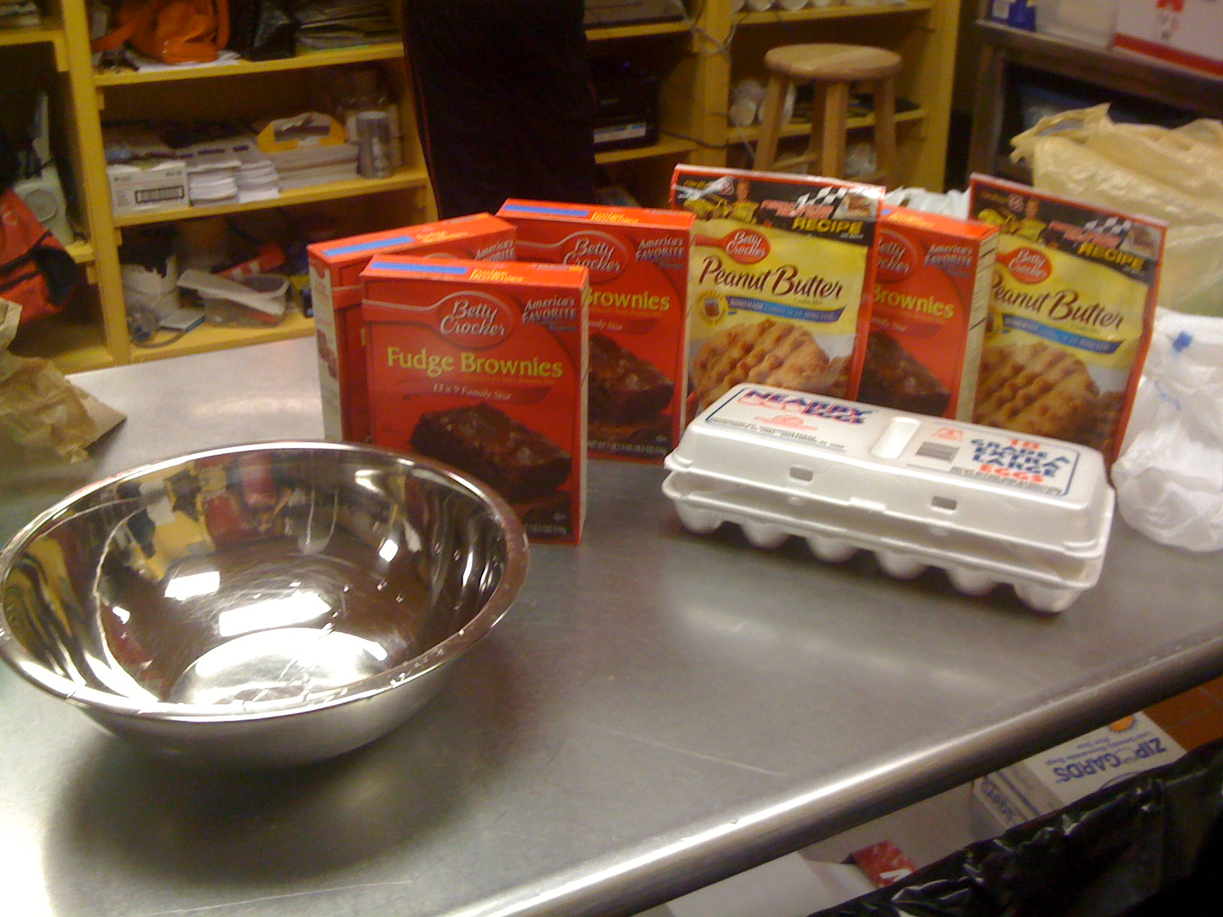
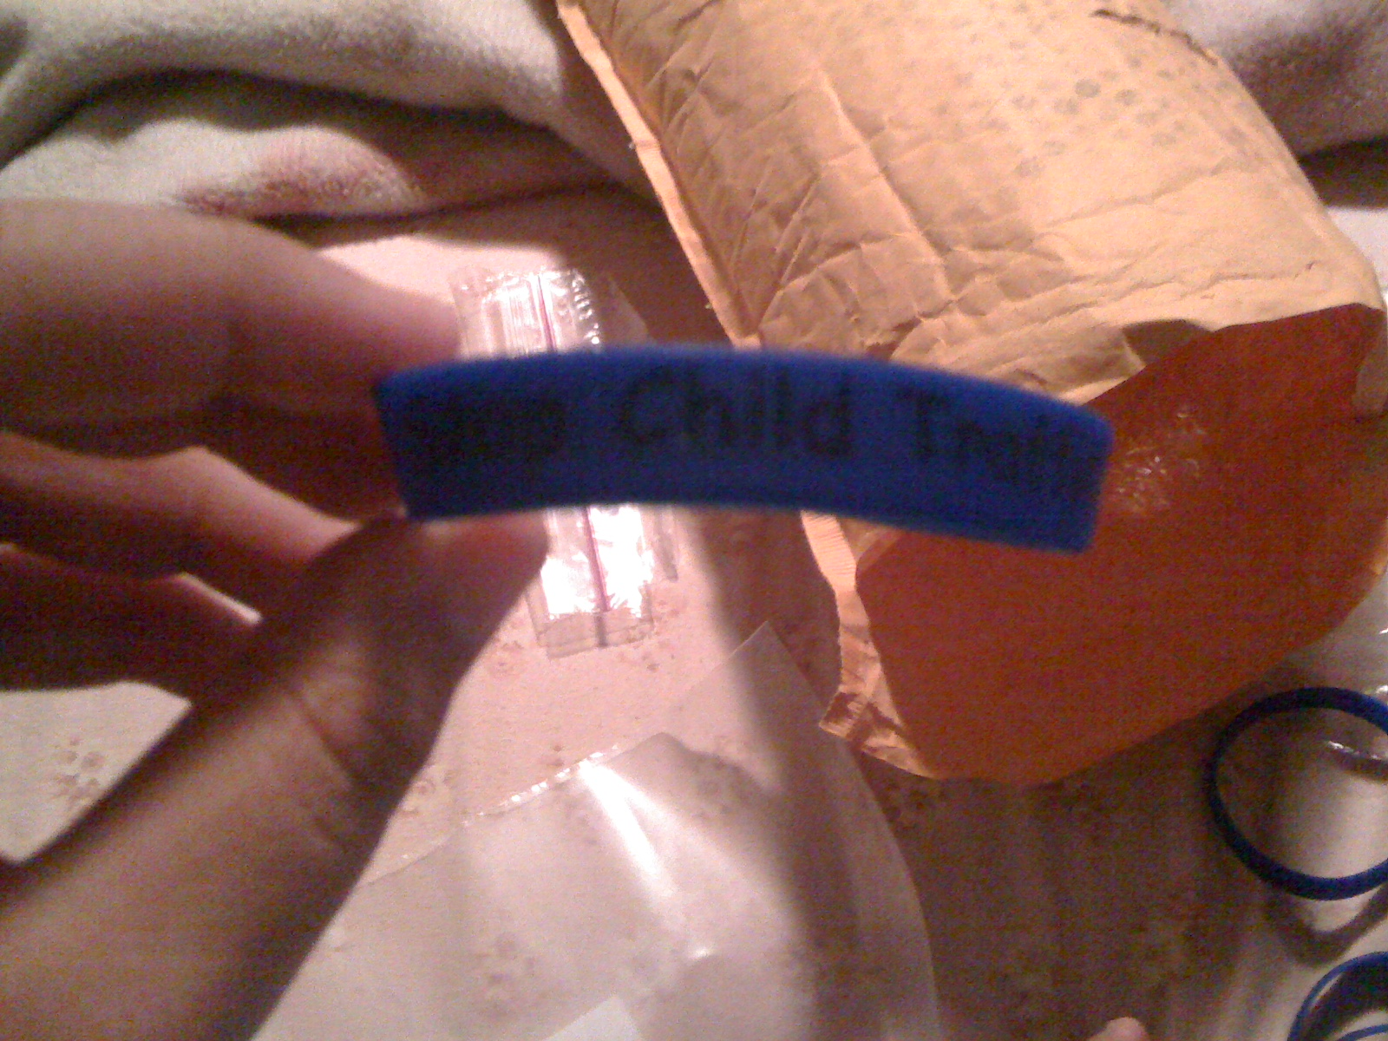
Application
Notes:
For my application I wanted to raise money. I did 3 main things to do that. First I made cans to put in local stores to get some change then I did a bake sale with Mrs. G and third I sold bracelets in school. All the money went to the Born2fly organization which helps prevent child trafficking.

Slide 39
VIDEO

Slide 40
Works Cited
Beyrer, Chris. “Global Child Trafficking.” Lancet 1 Dec. 2004: 16. eLibrary. Web. 2 Dec. 2009.
Bush, George W. “Remarks at the National Training Conference on Human Trafficking in Tampa, Florida.” Weekly Compilation of Presidential Documents 40.29 (2004): 1309. eLibrary. Web. 1 Dec. 2009.
Hodge, David R. “Sexual Trafficking in the United States: A Domestic Problem with Transnational Dimensions.” Social Work 53.2 (2008): 143. eLibrary. Web. 3 Dec. 2009.
“Human Trafficking.” Encyclopedia of Race and Racism. Ed. John Moore. Vol. 2. Detroit: Gale, 2008. 134-38. Global Issues in Context. Web. 3 Dec. 2009.
Scimone, Diana, et al., prod. Born2fly International. Born to Fly International, Inc., 2008. Web. 1 Dec. 2009. <http://www.born2fly.org/>.
Tran, Jonathan. “Sold Into Slavery.” Christian Century 124.24 (2007): 22. eLibrary. Web. 2 Dec. 2009.
United States Congress. “Section 2423. Transportation of Minors.” Gender Issues and Sexuality: Essential Primary Sources. Ed. Brenda Lerner and Adrienne Lerner. Detroit: Gale, 2006. 411-12. Global Issues In Context. Web. 3 DTodres, Jonathan. “Root out child trafficking with prevention.” The Atlanta Journal and Constitution (Feb. 2010): n. pag. eLibrary. Web. 2 Apr. 2010. ec. 2009.
Todres, Jonathan. “Root out child trafficking with prevention.” The Atlanta Journal and Constitution (Feb. 2010): n. pag. eLibrary. Web. 2 Apr. 2010.
Blackwill, Robert D. “Dealing with trafficking in persons: Another dimension of United States and India transformation.” DISAM Journal of International Security Assistance Management 25.4 (2003): 58. eLibrary. Web. 3 Apr. 2010.
Miller, John R. “Slave Trade.” Harvard International Review 27 (Jan. 2006): 70. eLibrary. Web. 3 Apr. 2010.
Buckley, Mary. “Young and Vulnerable.” The World Today 64 (Aug. 2008): 16. eLibrary. Web. 3 Apr. 2010.
Mrrusssss. “Steven Seagal sued for sexual harassment and human trafficking.” zimbio . N.p., 13 Apr. 2010. Web. 23 May 2010. <http://www.zimbio.com/>.
FanHouse Newswire. “ Alvin Robertson Apprehended, Charged With Sex Trafficking.” NBA Fanhouse . Aol Sports , 2 Feb. 2010. Web. 23 May 2010. <http://nba.fanhouse.com/>.

Slide 41
Conclusion
“Knowing is not enough; we must apply. Willing is not enough; we must do.”
-Johann Wolfgang von Goethe
Notes:
In conclusion I hope you have learned a lot about a topic that is kept hidden by society. I hope I’ve shown you a different side of the world that we do not know of. This tragedy not only happens in foreign countries, but is existing in our own. Society ignores this, but it does not mean that we have to. We can be the generation that makes a difference in a topic that is masked under excuses that make the public think it is ok. One person can make a difference and if we all raise our voices for the innocent and push past ignorance we can truly make our voices heard for those who cannot speak on their behalf.

