Slide 3
WHAT ARE
HUMAN RIGHTS?
human rights
pl.n.
The basic rights and freedoms to which all humans are entitled, often held to include the right to life and liberty, freedom of thought and expression, and equality before the law.
http://www.thefreedictionary.com/human+rights

Slide 4
Discrimination: | the action of discriminating against people; bigotry, intolerance, prejudice.
Discriminate: | make an unjust distinction in the treatment of different categories of people, especially on the grounds of race, sex or age.
Prejudice: | preconceived opinion that is not based on truth or experience; unjust behaviour formed on such a basis.
Preconceptions: | a preconceived idea or prejudice, formed before evidence for its truth or usefulness has been acquired.
Stereotype: | an oversimplified mental picture of a group of people who share certain characteristic qualities; often used in a negative sense; illogical yet deeply held beliefs that can only be changed through education; common stereotypes include various generalizations about arid predictions of behaviour based on racial groups, social status and wealth.
Stereotyping: | when we make allegations or predictions of behaviour about a group of people who share something in common.
Labels: | a classifying name applied to a person or thing, often with negative connotations; labels are often used for stereotypes.
The Bill of Rights: | legal statement of the rights given to everyone.
Violate: | break or infringe or transgress a rule or formal agreement.
Human rights: | rights which are believed justifiably to belong to every person.
Democracy: | a form of government in which the people have a voice in the exercise of power, typically through elected representatives.
Democratic processes: | processes or legal actions that can be taken to ensure that democracy is upheld, that human rights are not violated, ways of voicing public opinion.
Diversity: | being varied; a variety.

Slide 6
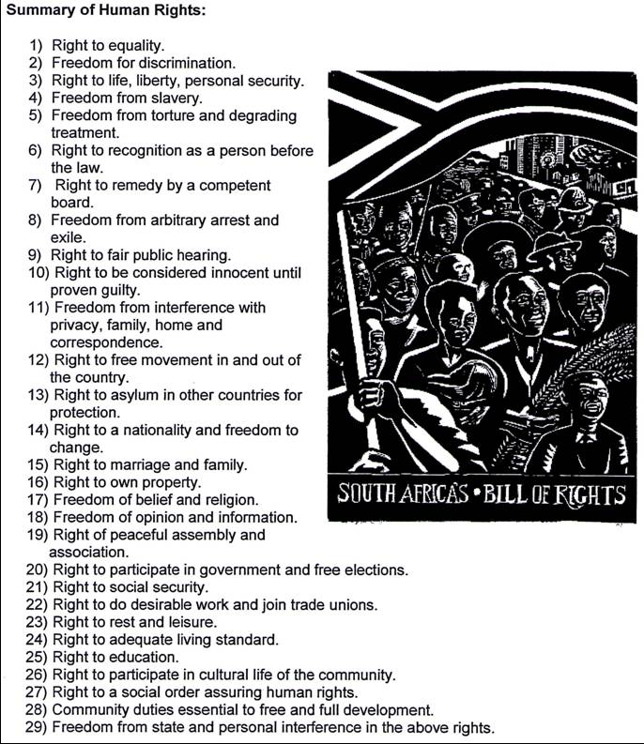

Slide 7
ACTIVITY:
Complete pg 57-61 in groups of 4-5
The campaigns will be displayed in class.
2. Complete the following essay in your support work file: you can support or not support this statement:
It’s the responsibility of the youth to ensure that human rights prevail and that inequality in South Africa ends for good.

